Slide 1
Welcoming the Stranger: A Biblical Conversation on Immigration
Matthew Soerens
U.S. Director of Church Mobilization, World Relief
National Coordinator, Evangelical Immigration Table
Notes:
Note global context, number of and definition of refugees, polarization between FEAR and COMPASSION

Slide 3
Some Troubling Statistics
According to LifeWay Research polling…
86% of Protestant pastors in the US affirm that Christians should “care sacrificially for refugees and foreigners”

Slide 4
Some Troubling Statistics
But…
Only 8% say their church is currently involved in serving refugees locally
Only 19% say their church is currently involved in caring for refugees internationally

Slide 5
Some Troubling Statistics
57% of evangelical Christians (and 69% of white evangelicals) say that the arrival of immigrants to their community presents a threat or a burden of some sort
Only 42% say it presents “an opportunity to introduce them to Jesus” (LifeWay Research)

Slide 6
Some Troubling Statistics
Just 12% of evangelical Christians say their views on the arrival of refugees and other immigrants are primarily informed by the Bible

Slide 7
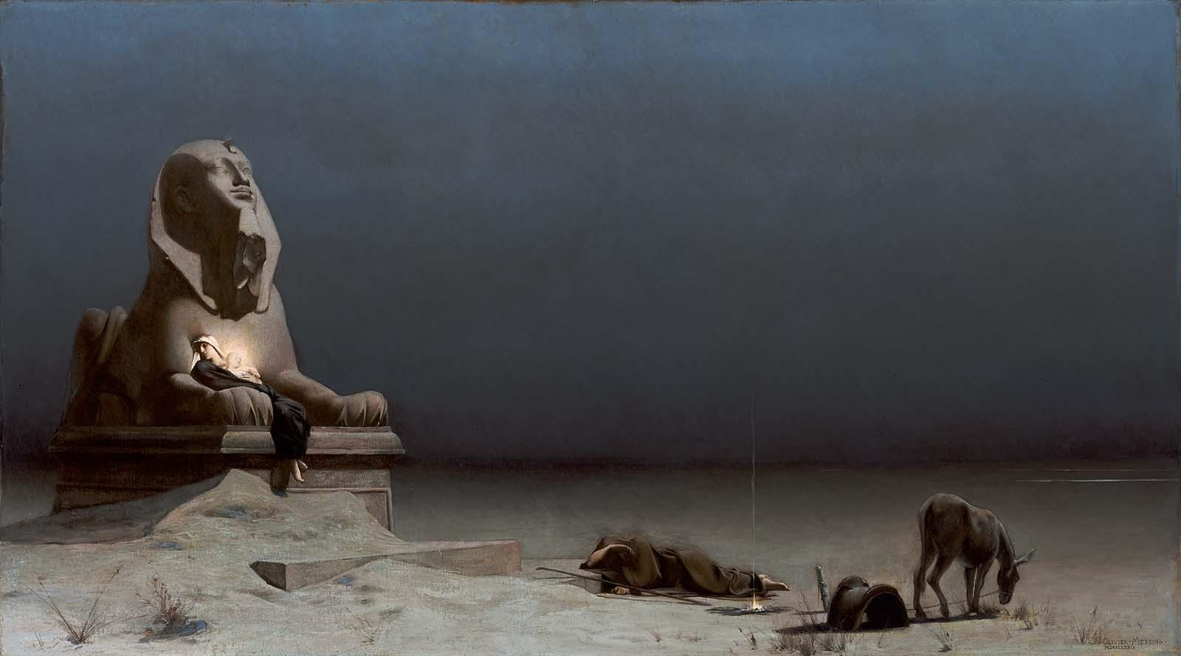
Thinking Biblically
Jesus Himself was a refugee (Matt. 2:13-18)

Slide 8
Legal Definition of a Refugee
A refugee is a person who has fled their country because of a well-founded fear of persecution on account of their
Globally, 25.4 million people meet this definition, not including more than 40 million who are “internally displaced” (UN High Commissioner for Refugees)
Race
Religion
Political Opinion

Slide 9
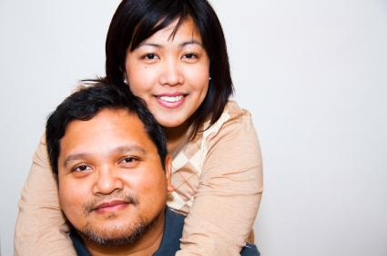
Thinking Biblically
Refugees and other immigrants are made in the Image of God and possess inherent dignity and potential (Gen. 1:26-27)
Notes:
Economic notes:
- Uniquely entrepreneurial, citing example of Sergey Brin
- 20 years post arrival, refugee adults contribute $21K more in taxes than they receive in governmental assistance and services

Slide 10
Economics of Refugees & Immigration
40% of Fortune 500 Companies were founded or cofounded by an immigrant or their child (Forbes Magazine)
20 years after arrival, the average refugee adult has contributed approximately $21,000 more in taxes than they have received in governmental assistance and services at all levels (University of Notre Dame study)
Almost all economists believe that the net economic impact of immigration on the U.S. is positive, including 96% of economists surveyed by the Wall Street Journal who believe that the net economic impact of illegal immigration is positive

Slide 11
Economics of Refugees & Immigration
Contrary to widespread misconception, immigrants who are unlawfully present cannot receive federal means-tested public benefits, but they can—and do—pay taxes, including
In Texas, contributing $1.1 billion in sales taxes and $495 million in property taxes annually (Institute on Taxation & Economic Policy)
Federally, contributing $12 billion annually to Social Security that they cannot benefit from (Social Security Administration)

Slide 12
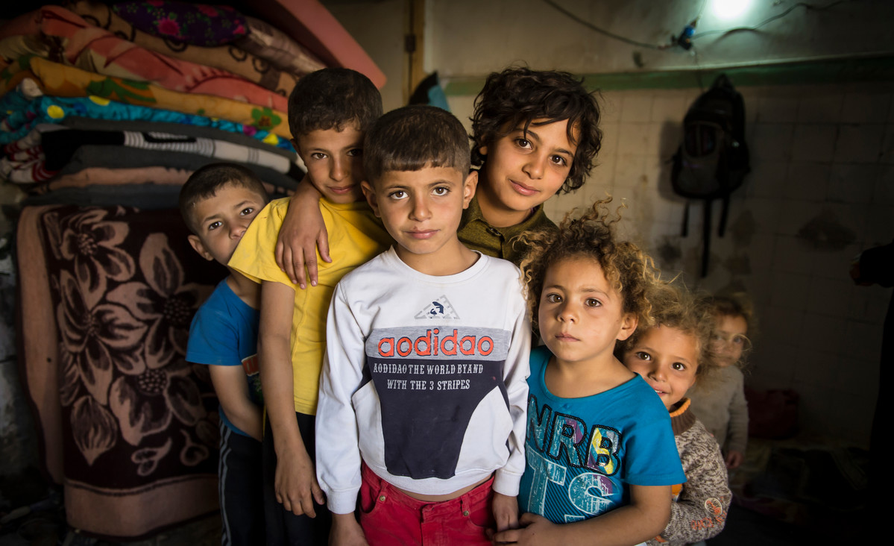
Thinking Biblically
God loves and cares for the vulnerable: the orphan, the widow, and the foreigner (Deut. 10:17-19; Ps. 146:9; Zech. 7:9-10; Jer. 22:3; Mal. 3:5)
Notes:
Unique vulnerability of women and children, particularly to sexual violence:
More than half of the refugees in the world are children; about half are female
One study found that 94% of displaced households in Sierra Leone reported at least one incident of sexual assault. (UNICEF: https://www.unicef.org/emerg/files/gl_sgbv03.pdf)
More than 21% of refugees and displaced women in a study considering 14 countries had experienced sexual violence (US National Institutes of Health: https://www.ncbi.nlm.nih.gov/pmc/articles/PMC4012695/)

Slide 13
Unique Vulnerability of Refugees & Other Immigrants
72% of refugees admitted to the US recently have been women or children, including single mother-headed families (US State Department)
Undocumented immigrants brought to the US as children who registered for Deferred Action for Childhood Arrivals (DACA) are poised to lose their work authorization & deportation protections
Though about 14% of the overall US population, immigrants made up
95% of victims of labor trafficking
17% of sex trafficking victims in the US (Faith Alliance Against Slavery and Trafficking analysis of US Department of Justice Prosecution Data)

Slide 14
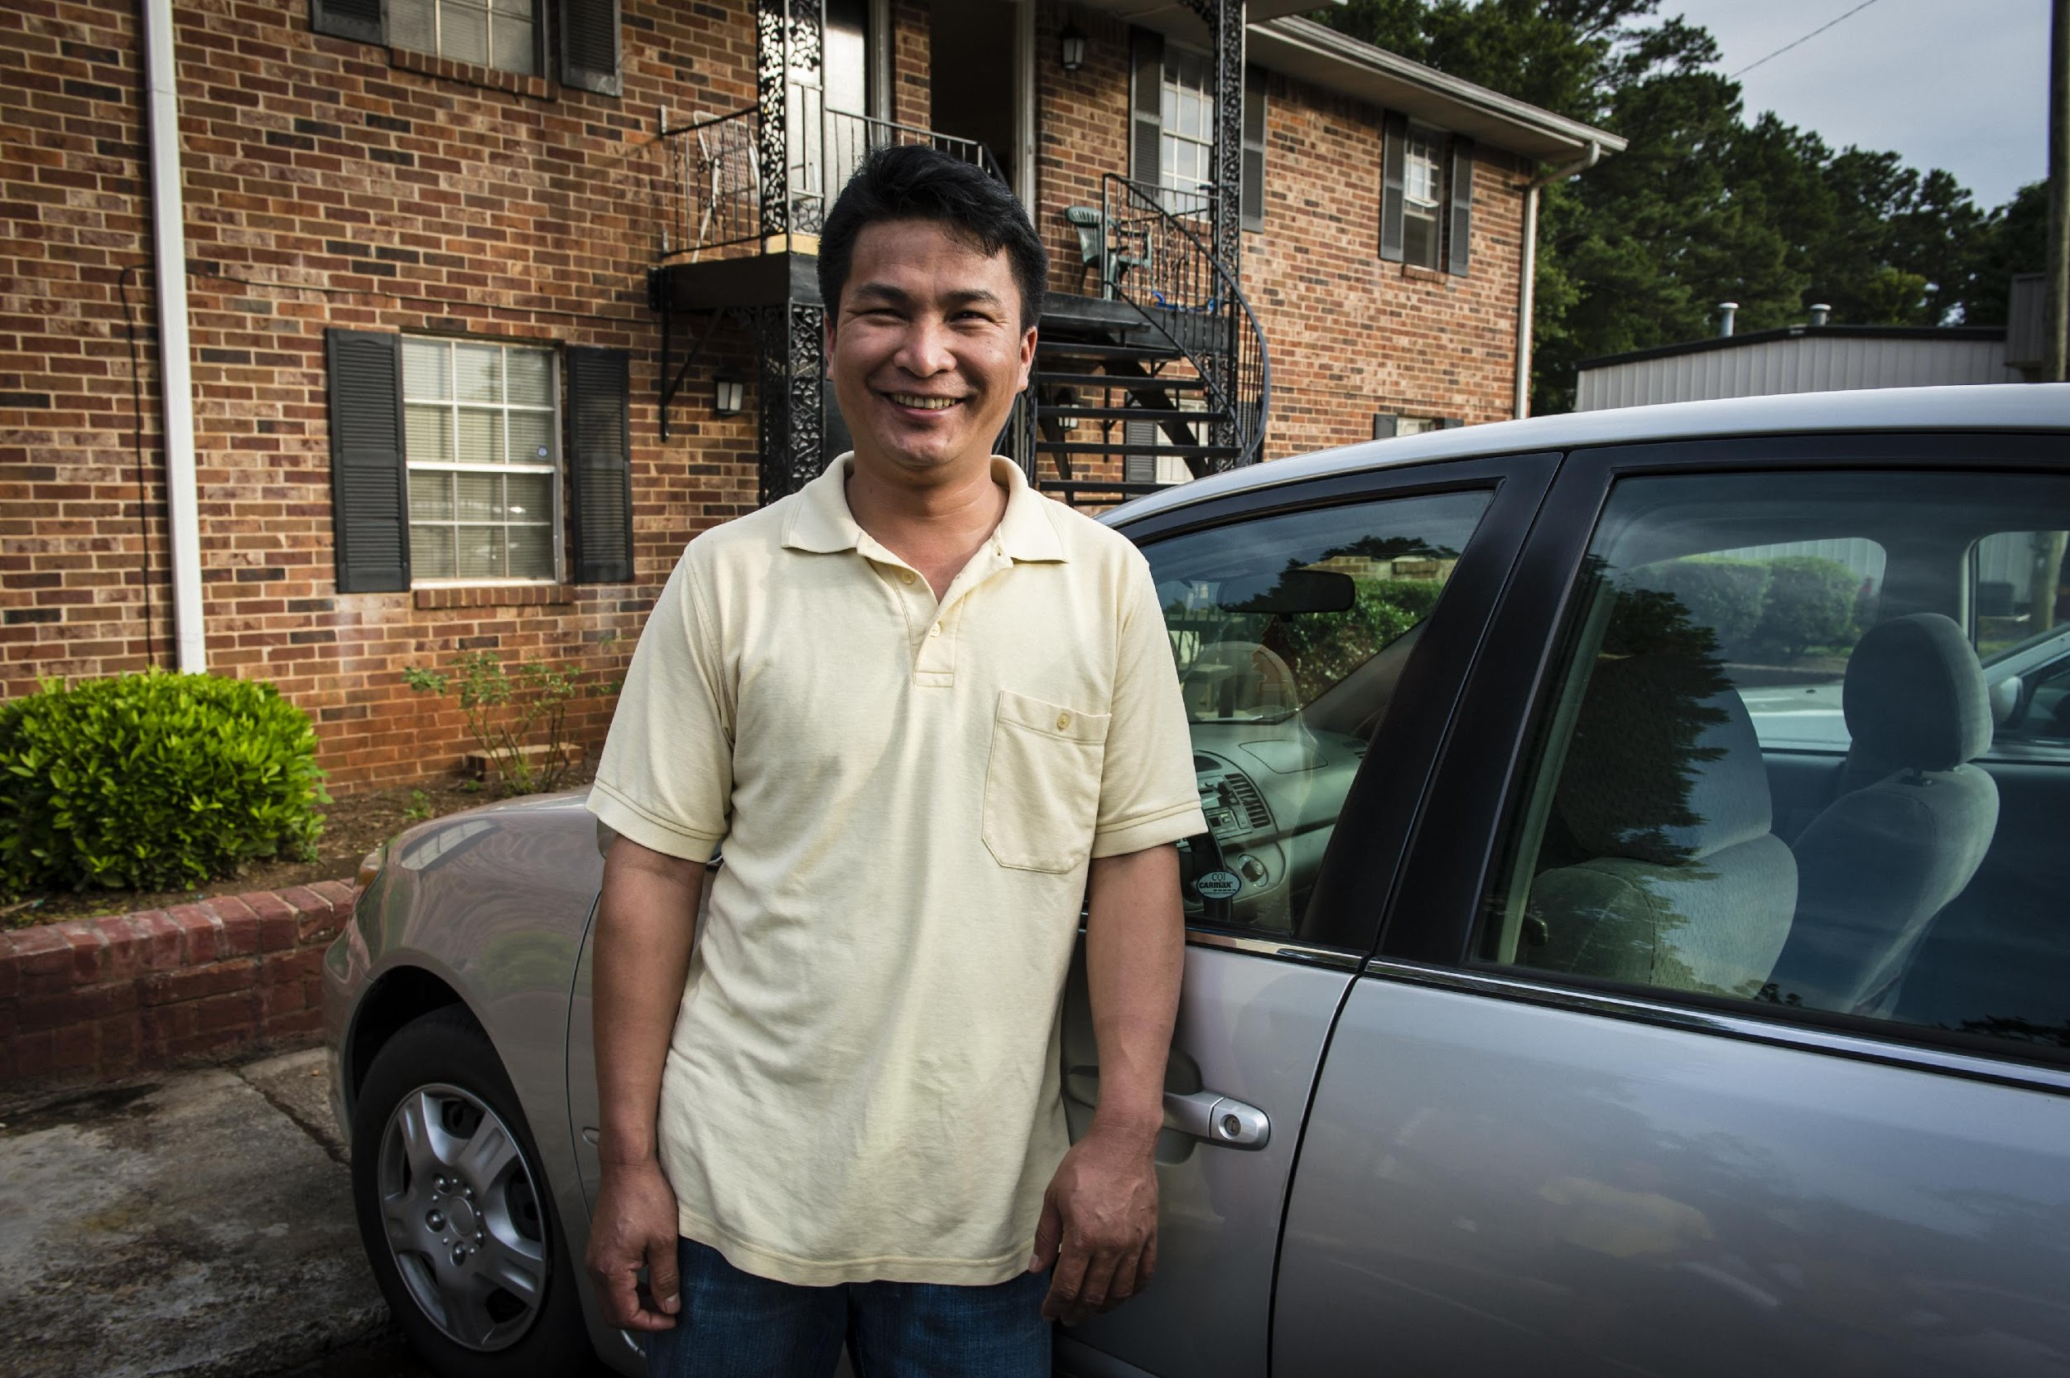
Thinking Biblically
God commands the Israelites to remember their own history of mistreatment as foreigners (Ex. 22:21; Deut. 26:1-12)
Notes:
Exodus 22:21 “Do not mistreat or oppress a foreigner, for you were foreigners in Egypt.
Deut 26: “My father was a wandering Aramean, and he went down into Egypt with a few people and lived there and became a great nation, powerful and numerous. ⁶ But the Egyptians mistreated us and made us suffer, subjecting us to harsh labor

Slide 15
History of Immigration to the US
1882: first significant federal restrictions on immigration with the Chinese Exclusion Act, followed by additional restrictions
1890 - 1910: at height of Ellis Island era, a record high 15% of US population is foreign-born
1924: National Origins Quota Act dramatically restricts immigration & creates first requirement of a visa to immigrate to the US
1965: Major immigration reform shifts eligibility to immigrate to be based on family or employer sponsorship, increasing immigration from Asia & Africa

Slide 16
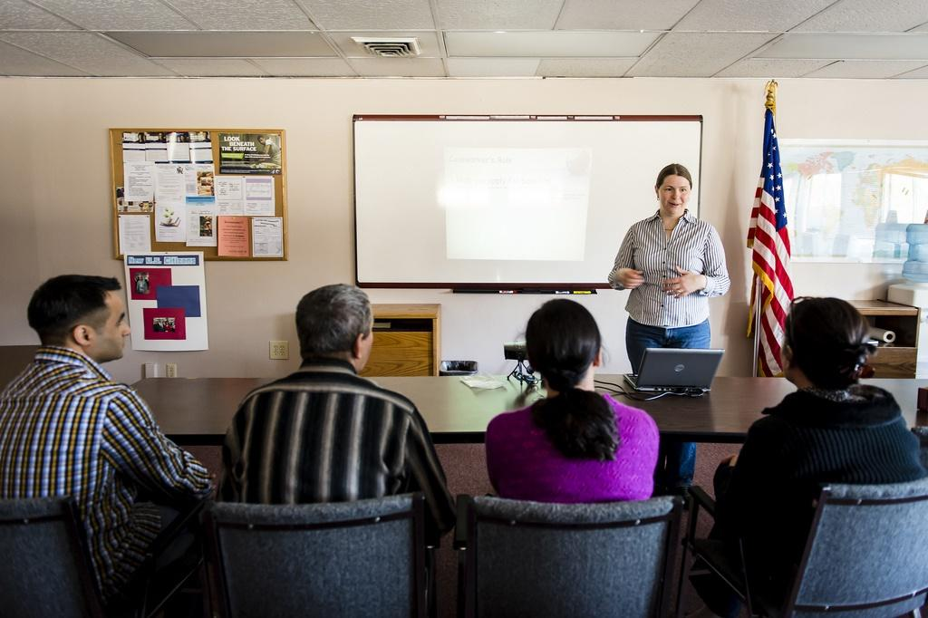
Thinking Biblically
We are commanded to love our neighbors—without caveats (Lev. 19:18, 34; Luke 10:25-37)
Notes:
We need not be afraid—note realities of US refugee vetting process—but even if there was risk, we would be called to love our neighbors

Slide 17
Refugees and Terrorism
Refugees admitted through the U.S. Refugee Admissions program already are subjected to the most thorough vetting of any category of visitor or immigrant to the US
Since the Refugee Act of 1980, 0 Americans have lost their life in a terrorist attack perpetrated by a refugee
The odds of the average American being killed by a refugee-turned-terrorist are 1 in 3.6 billion (Cato Institute)

Slide 18
Immigrants and Crime
Immigrants are incarcerated at lower rates than US citizens
Incarceration rates among people ages 18 through 54
1.53% among native-born US citizens
0.47% among lawfully present immigrants
0.85% among unlawfully present immigrants (including those charged with criminal violations of immigration law, including improper entry) (Cato Institute)
While the unlawfully present population tripled from 1990 to 2013, violent crime rates fell by 48% nationally (American Immigration Council analysis of FBI data)

Slide 19
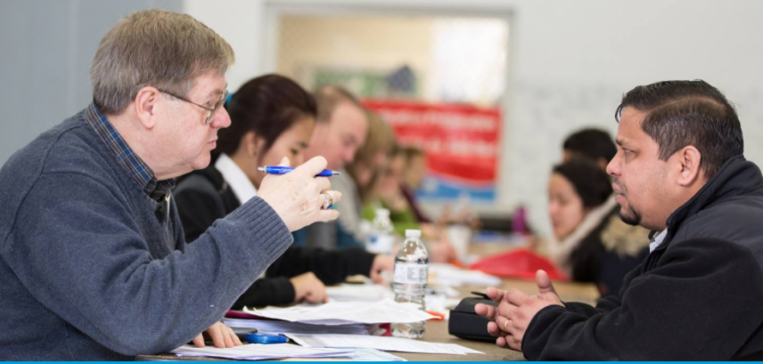
Thinking Biblically
We are commanded to be subject to governing authorities (Rom. 13:1-5; 1 Peter 2:13-14, 17)

Slide 20
Immigration Legal Statuses
About 70% of immigrants in the US are lawfully present, including all who are admitted as refugees
Among the roughly 11 million immigrants who are unlawfully present in the US, nearly half entered on a temporary visa but overstayed, and they come from all over the world, not just from Mexico (Center for Migration Studies)
Under current law, legal immigration is limited to:
Refugees and Asylees
Diversity Visa Lottery Winners

Slide 21
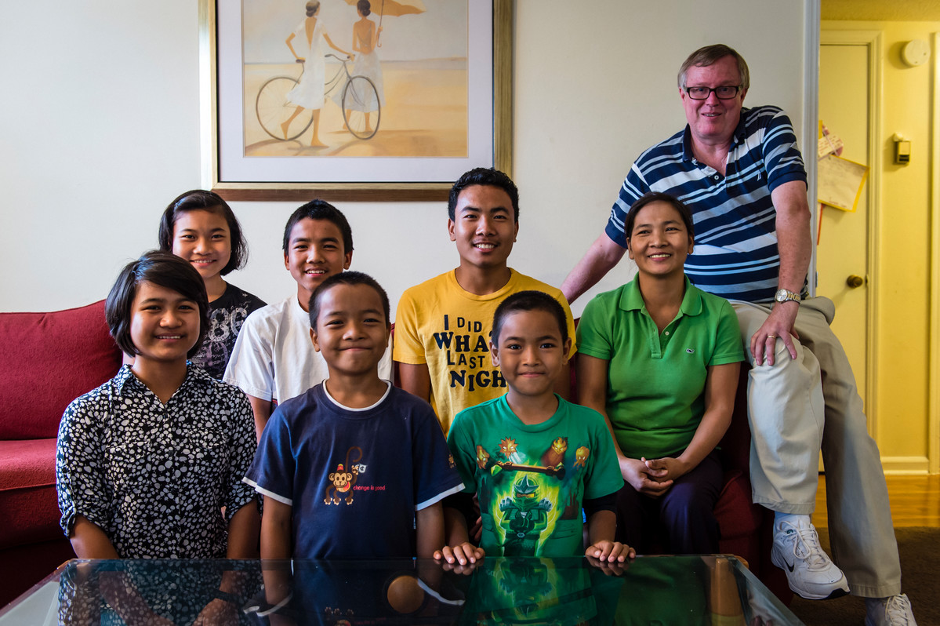
Thinking Biblically
The Church is one body—made up of distinct, interdependent parts—and when one part suffers, all suffer (1 Cor. 12:12-27)
Notes:
Per Pew Research Center, overall Christian affiliation from 2007 to 2015 declined from 78% to 71% in just 7 years. Evangelical affiliation remained flat—but only because non-white evangelicals increased significantly while white evangelicals declined. Non-white share of evangelicals in the US increased from 19% to 24% just in 7 years, and foreign-born percentage by 33%,

Slide 22
Immigration and Church Growth
According to a 2015 Pew Research Center report, between 2007 and 2014:
Overall Christian affiliation in the US declined from 78.4% to 70.6%
Evangelical affiliation remained roughly flat
The non-white share of American evangelicals rose from 19% to 24%
The number of Latino evangelicals increased by 65%
The share of evangelicals who are immigrants increased by 33% to 16% of all US evangelicals

Slide 23
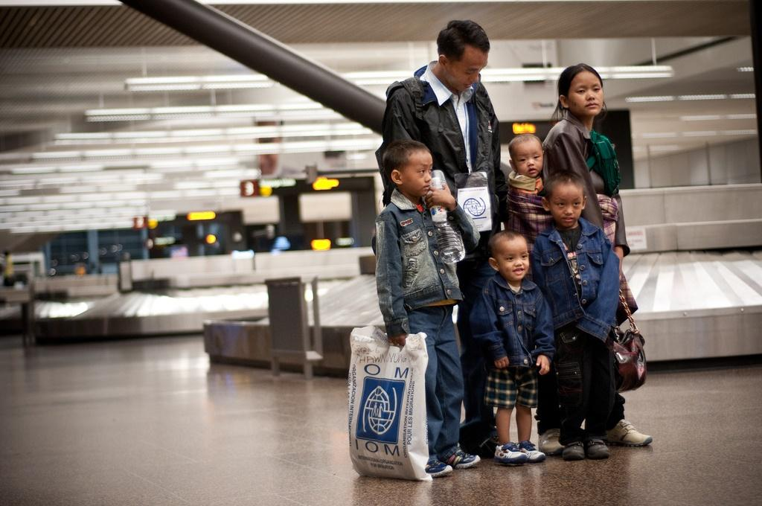
Thinking Biblically
When we extend compassion to persecuted brothers and sisters in Christ, we do so to Christ Himself (Matt. 25:31-45)
Notes:
Note that plurality of refugees to the U.S. last decade were Christians, including many persecuted particularly because of their faith. But about 27,000 fewer Christians came in the past year, compared to the previous year, a decline of more than 60%

Slide 24
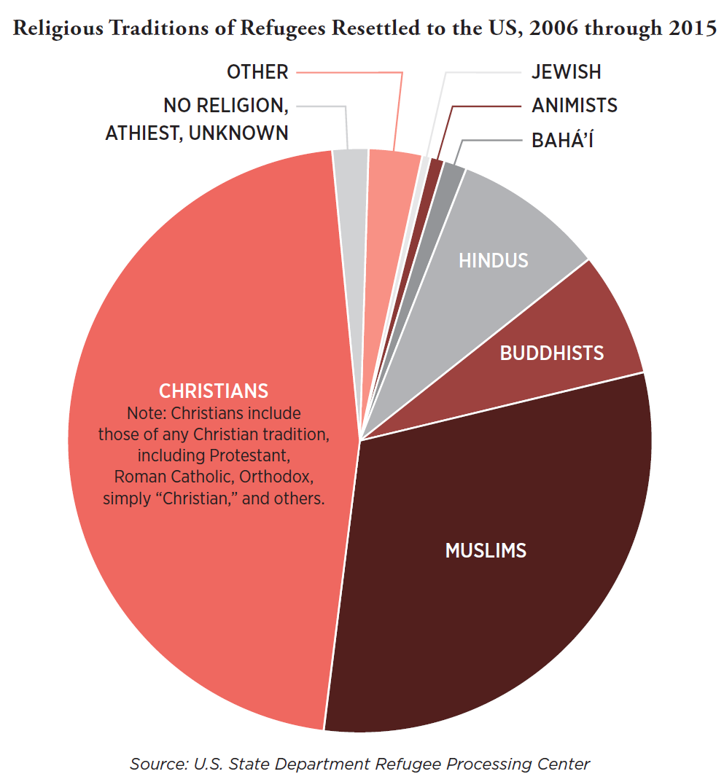
Religious Demographics of Refugees Resettled to the US

Slide 25
Persecuted Christians and the US Refugee Program
 | 2016 | 2018 (as of June 30) | Rate of Decline
Christian Refugees from All Countries | 42,105 | 7,609 | 63.6%
Syrian Christians | 121 | 6 | 90.0%
Iraqi Christians | 1,966 | 14 | 98.6%
Iranian Christians | 2,263 | 2 | 99.8%
Burmese Christians | 7,057 | 1,062 | 69.7%
Christians from Countries Where Christians Face "High” or “Most Extreme” Persecution according to Open Doors USA 2017 Watch List | 16,154 | 1,912 | 76.1%
(Source: US State Department Refugee Processing Center data as of June 30, 2018)

Slide 26
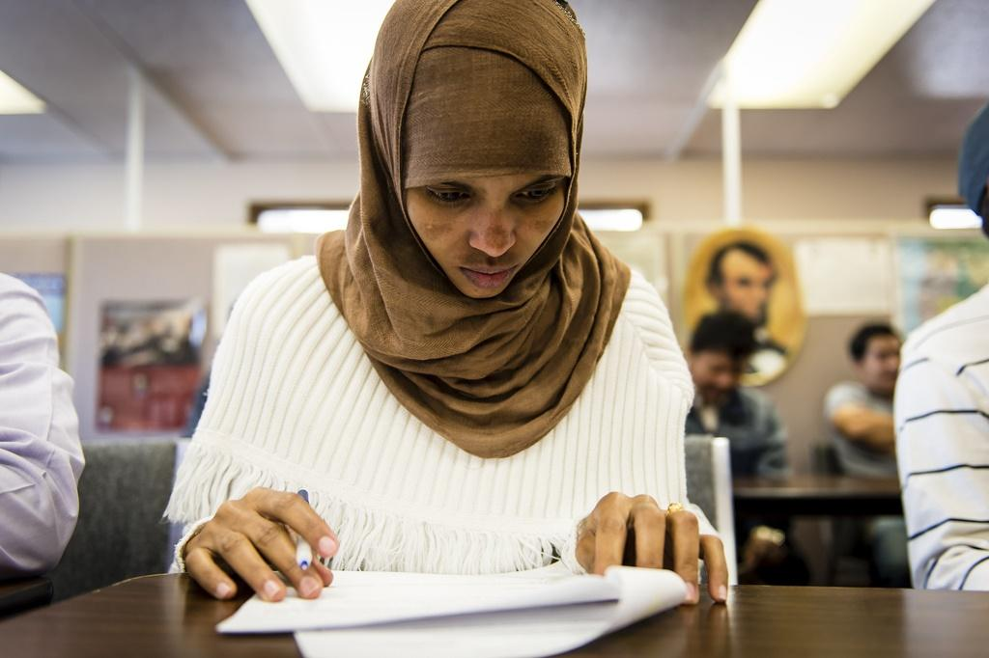
Thinking Biblically
By welcoming those who are not yet believers, we have opportunities to “give an answer to everyone who asks” for the hope within us and to “make disciples of all nations” (1 Pet. 3:15, Matt. 28:19)

Slide 27
A Missed Missional Opportunity
Among people of non-Christian religious traditions in North American—most of them refugees or other immigrants—60% say they do not personally know a Christian (Gordon-Conwell Theological Seminary Center for the Study of Global Christianity, analyzed by Christianity Today)
Just 35% of white evangelicals in the US say they personally know a Muslim, and even fewer know a Hindu or a Buddhist (Pew Research Center)

Slide 28
A Missed Missional Opportunity
Something is missionally malignant whenever we are willing to make great sacrifices to travel the world to reach a people group but are not willing to walk across the street.
Missiologist J.D. Payne

Slide 29
A Christian Response to Refugees and Immigration
Prayer
Listening
Empowering Churches Abroad
Advocacy
Serving Locally
Evangelism

Slide 30
A Christian Response to Refugees and Immigration
Prayer
Pray without ceasing (1 Thes. 5:17 ESV)
The harvest is plentiful, but the laborers are few. Therefore pray earnestly to the Lord of the harvest to send out laborers into his harvest (Luke 10:2 ESV)
First of all, then, I urge that supplications, prayers, intercessions, and thanksgivings be made for all people, for kings and all who are in high positions, that we may lead a peaceful and quiet life, godly and dignified in every way (1 Tim. 2:1-2 ESV)

Slide 31
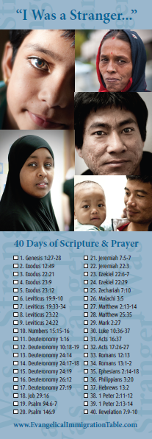
A Christian Response to Refugees and Immigration
Listening
To Scripture
“I Was a Stranger” Challenge (bookmark or digital via YouVersion’s Bible app)
To Immigrants’ Stories
The Stranger (www.TheStrangerFilm.org)
Voices of Christian Dreamers (www.ChristianDreamers.US)

Slide 32
A Christian Response to Refugees and Immigration
Empowering Churches Abroad
Coming alongside churches around the world to address the root causes that compel migration
Poverty
Persecution
War
Natural and Environmental Disasters

Slide 33
A Christian Response to Refugees and Immigration
Advocacy
Speak up for those who cannot speak for themselves (Prov. 31:8)

Slide 34
A Christian Response to Refugees and Immigration
Evangelical Statement of Principles for Immigration Reform
As evangelical Christian leaders, we call for a bipartisan solution on immigration that:
Respects the God-given dignity of every person
Protects the unity of the immediate family
Respects the rule of law
Guarantees secure national borders
Ensures fairness to taxpayers
Establishes a path toward legal status and/or citizenship for those who qualify and who wish to become permanent residents

Slide 35
A Christian Response to Refugees and Immigration
Practical Ways to Advocate
Sign the Evangelical Statement of Principles (joining a broad range of denominational leaders, college & seminary presidents, parachurch ministry executives & local pastors throughout the country)
Meet with your Member of Congress or his/her staff
Write an Op-Ed for the local newspaper
Stay informed & contact your elected officials (tools at www.seekingpeace.org)

Slide 36
A Christian Response to Refugees and Immigration
Key Federal Policy Questions Right Now
Refugee arrivals at historically low levels
“Dreamers” losing work permission and deportation protections
Temporary Protected Status lapsing for several countries
Aftermath of “zero tolerance” policy at US-Mexico border separating children from parents
Proposals to significantly limit lawful migration

Slide 37
A Christian Response to Refugees and Immigration
Serving Locally
Seek the Peace (Dallas) www.seekingpeace.org
World Relief Fort Worth www.worldrelieffortworth.org

Slide 38
A Christian Response to Refugees and Immigration
Evangelism
Go and make disciples of all nations, baptizing them in the name of the Father, and of the Son, and of the Holy Spirit (Matt. 28:19 NIV)
Always be ready to give an answer to everyone who asks you to give the reason for the hope that you have. But do this with gentleness and respect (1 Pet. 3:15 NIV)

Slide 39
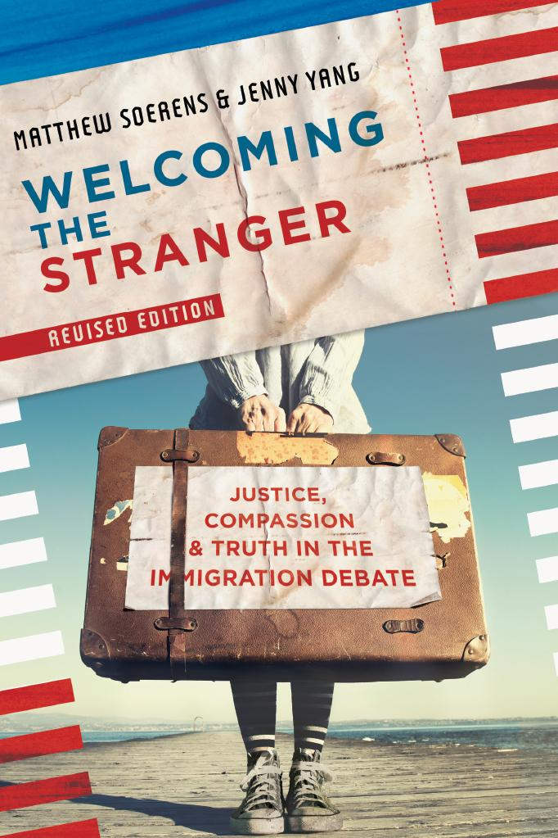
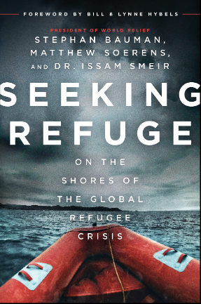
A Christian Response to Refugees and Immigration
Further Resources
Books
Websites
www.worldrelief.org
www.SeekThePeace.org
www.welcomingthestranger.com
6 session small group curriculum with videos
www.EvangelicalImmigration
Table.com
Preaching Resources
“I Was a Stranger” Challenge Bible-Reading Guide
“The Stranger” Film

Slide 40
Thinking Biblically
We are commanded to “practice hospitality” which literally means to practice loving strangers (Rom. 12:13)—and when we do so, we may be welcoming angels unaware (Heb. 13:2)

Slide 41
Q&A
Stay up to date:
- Twitter: @MatthewSoerens
@WorldRelief
@Seek_the_Peace
- Facebook:
Matthew Soerens
World Relief
Seek the Peace

